Slide 1
IMPACT OF MIGRATION ON GDP
Presented by: Martha, Nithya, Donicia
July 2019

Slide 2
Assumptions
The analysis was conducted using two data sources:
Data Sources:
World Bank - GDP (US$) current report (last published 2018)
United Nations Migration Data (last published 2017)
Years presented are 2005,2010,2015 and 2017.
2017 was the last year published by the United Nations.
The top 20 countries were selected using the total number of migrants from country of origination over the years selected.
Countries are categorized within the World Bank GDP data and mapped to United Nations Migration Data.

Slide 3

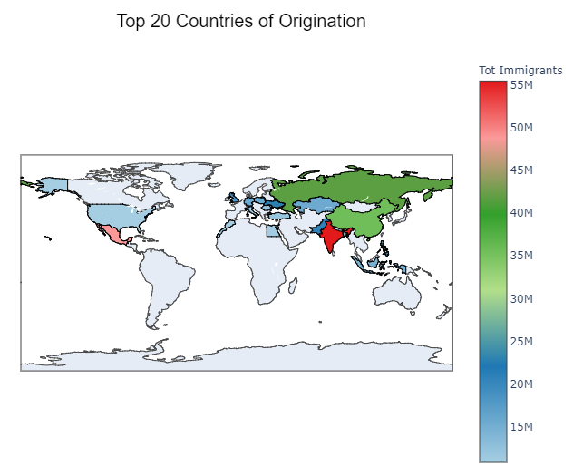
International migrant population
This dataset presents origination patterns of migration by country are presented for the years 2005, 2010, 2015 and 2017.

Slide 4

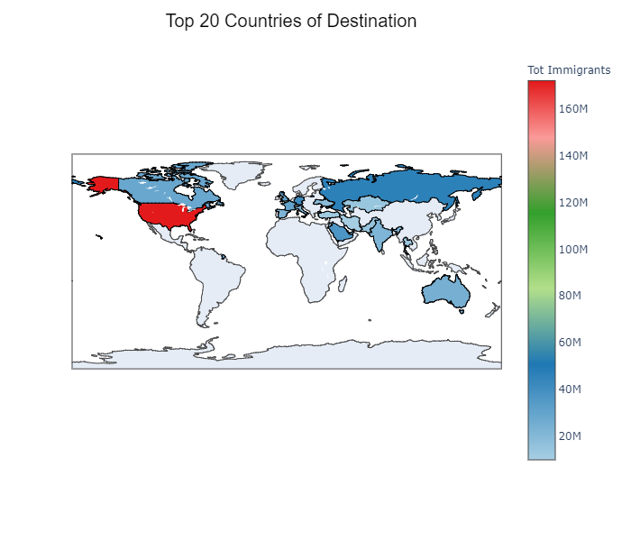
International migrant population
This dataset presents estimates of international migrant population by the top 20 destinations.

Slide 5
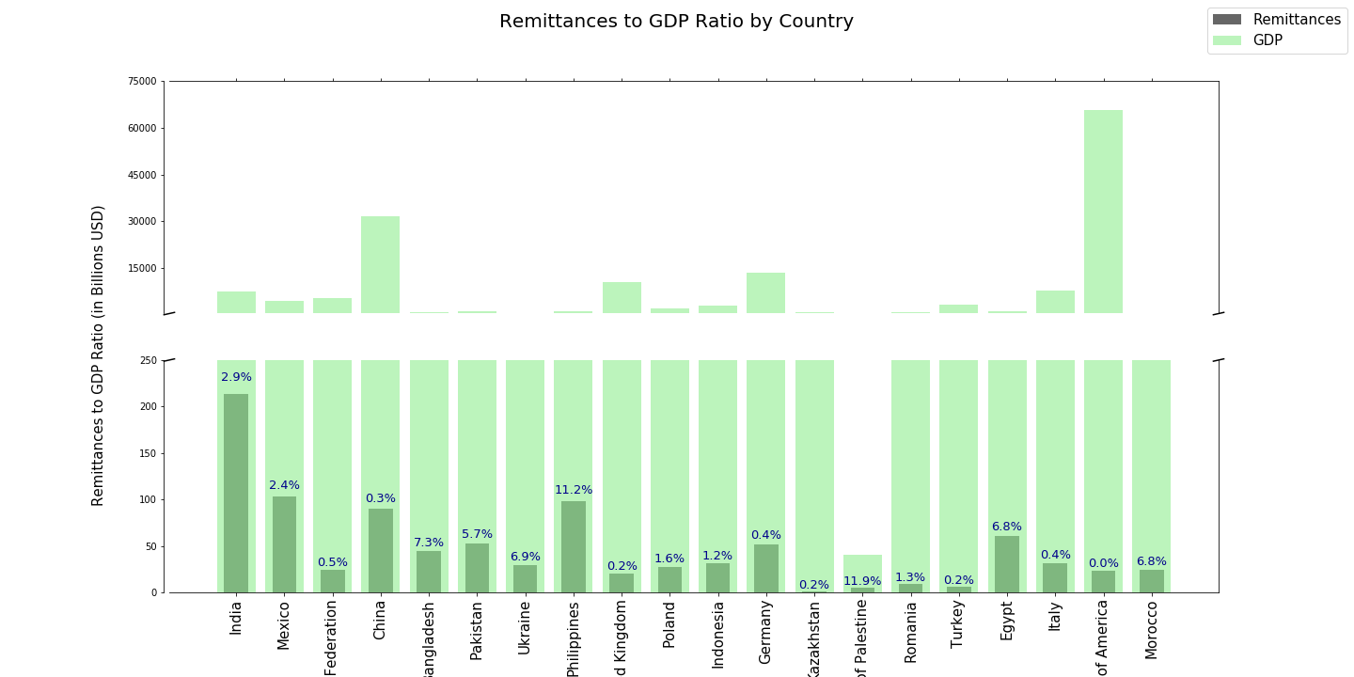
PERSONAL REMITTANCES TO GDP RATIO BY COUNTRY

Slide 6
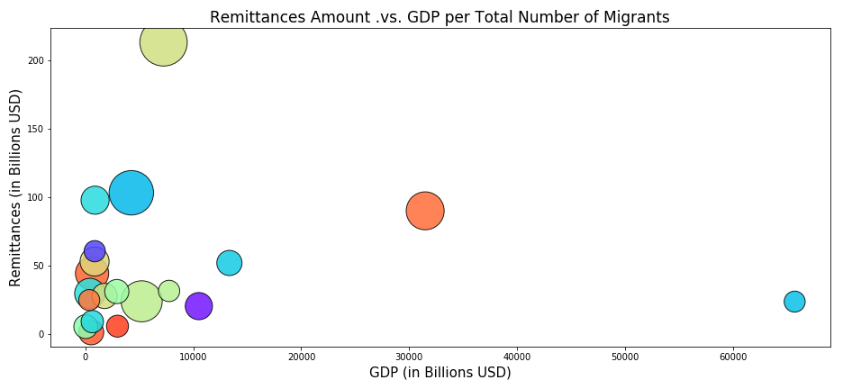
REMITTANCES AMOUNT VS GDP PER TOTAL NUMBER OF MIGRANTS
India
Mexico
China
Russia
United States

Slide 7
Remittances of low-income countries and migration ratio
Low Income
Lower Middle Income
India
Pakistan
Upper Middle
Income
United Kingdom
Poland
High Income
Mexico
Germany
Italy
United States of America
Bangladesh
Ukraine
Philippines
Indonesia
State of Palestine
Egypt
Morocco
Russian Federation
China
Kazakhstan
Romania
Turkey

Slide 8
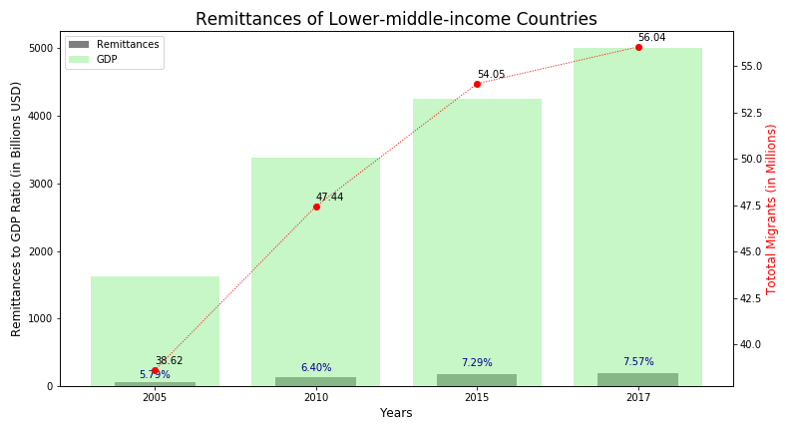
Remittances of low-middle income countries and migration ratio
This dataset presents remittances to GDP ratio and the migrant flow for the lower-middle income countries over a period of 12 years.

Slide 9
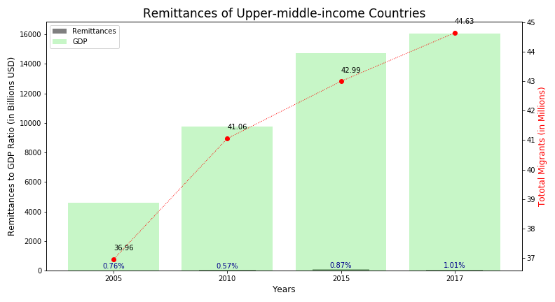
Remittances of upper-middle income countries and migration ratio
This dataset presents remittances to GDP ratio and the migrant flow for the upper- middle income countries over a period of 12 years.

Slide 10
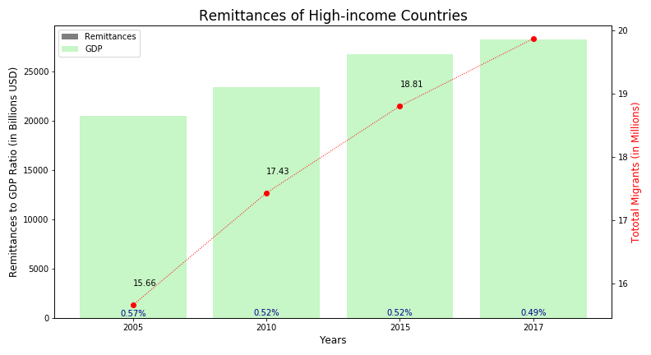
Remittances of high income countries and migration ratio
This dataset presents remittances to GDP ratio and the migrant flow for the high income countries over a period of 12 years.

Slide 11
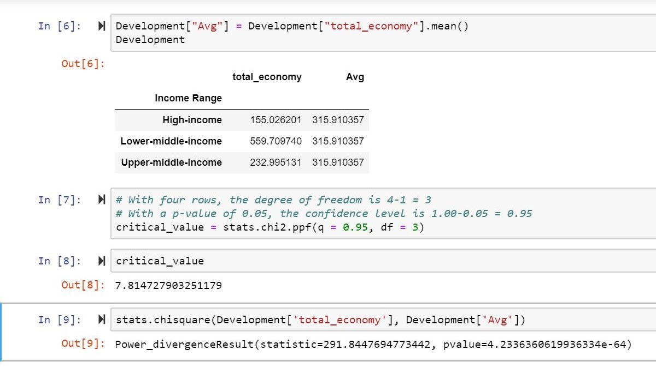
CHI SQUARE TEST
Is there a relationship between income of a country and the personal remittances received?
Null hypothesis - Regardless of income level they will send the same amount of remittances back.
P-value is a low value
The null hypothesis is False. The income level of origination countries really affects the amount of money sent back.

Slide 12
CONCLUSION
Direct co-relation – not all countries are the same.
Sub categories – low income countries are sending remittances back home but not other categories.
Helping economy in the origination countries

Slide 13
Technical aspects
Sources of Data:
United Nations - Department of Economic and Social Affairs. International Migration (https://www.un.org/en/development/desa/population/migration/data/estimates2/estimates17.asp)
World bank – Economy and Growth (https://data.worldbank.org/topic/economy-and-growth )
Cleanup Process
Data in XLS or CSV format. We uses Excel to cleanup logos and headers
Once all data was in CSV format we manipulate it in Pandas
Migration Data:
Using a country catalog, we filtered the migration and economic data to drop any information NOT related to countries (regions, classifications, etc.) and obtained countries’ additional information (region, development level, income level)
Format in migration data did NOT help manipulation, so it was changed: from columns to rows, ellipses, commas in the numbers
Top countries (origin and destination) were founds and CSV produced for plotting
Economic Data:
Using a country catalog, we filtered the migration and economic data to drop any information NOT related to countries (regions, classifications, etc.)
Countries with missing economic data (GDP or remittances) had to be dropped
Surprises: top 20 countries of origination, flow between India and Pakistan, no low income countries in the top 20 list
Problems: not the same countries in both sources), format in migrant information, country names

Slide 14
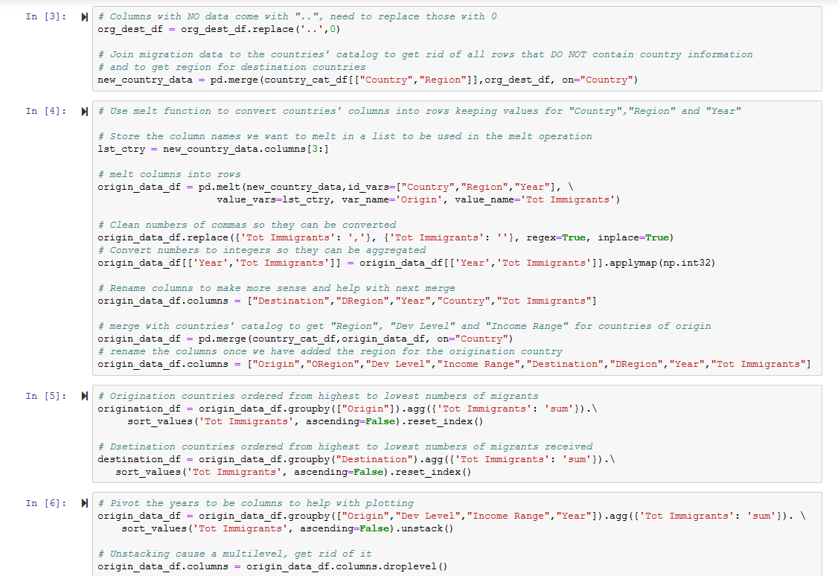

Slide 15
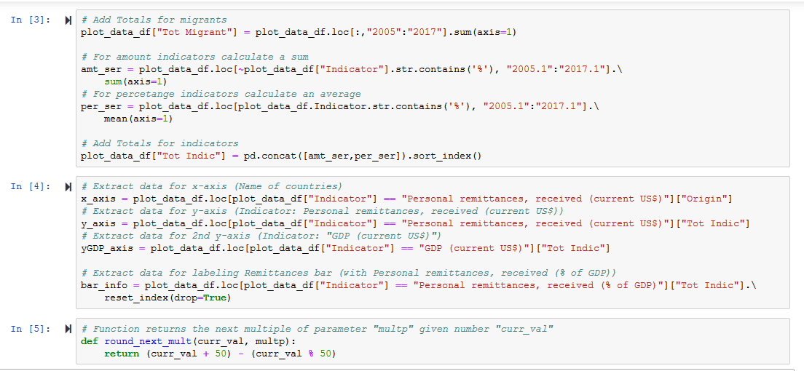

Slide 16
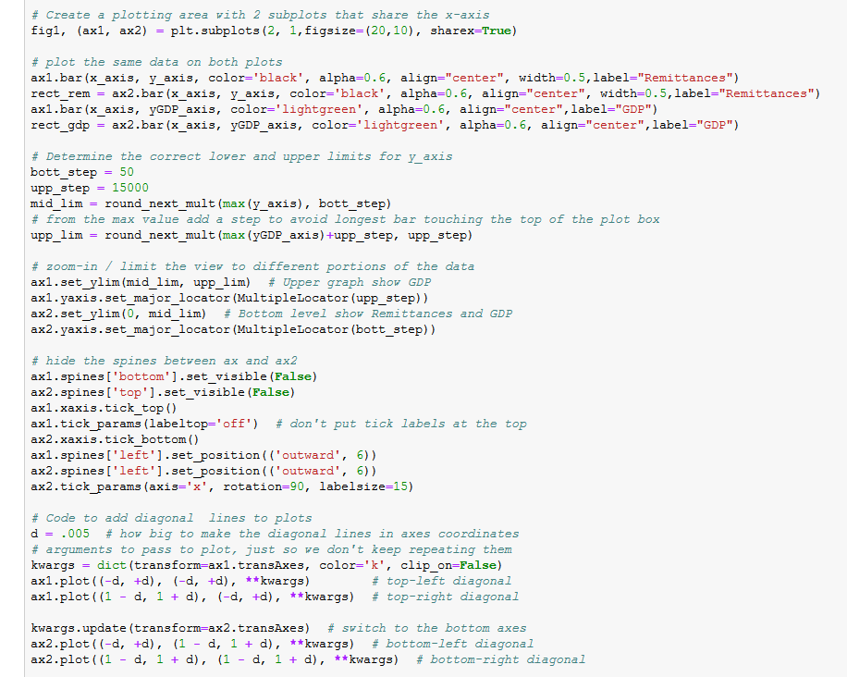

Slide 17


Slide 18
THANK YOU

